Slide 1
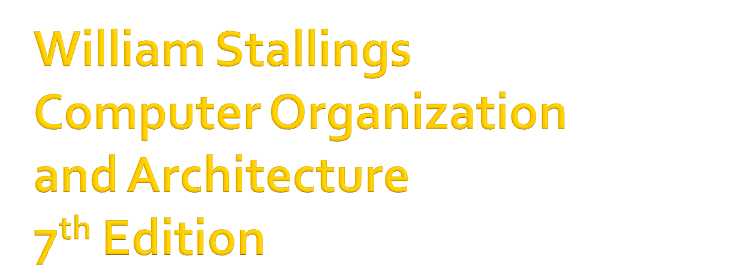
Chapter 1
Introduction

Slide 2

Computer Evolution and Performance
Computer Interconnection Structures
Internal Memory
External Memory
Input/Output
Operating Systems Support
Computer Arithmetic

Slide 3

CPU Structure and Function
Reduced Instruction Set Computers
Superscalar Processors
Control Unit Operation
Microprogrammed Control
Multiprocessors and Vector Processing

Slide 4

http://WilliamStallings.com/COA/COA7e.html
  links to sites of interest
  links to sites for courses that use the book
  errata list for book
  information on other books by W. Stallings
http://WilliamStallings.com/StudentSupport.html
  Math
  How-to
  Research resources
  Misc

Slide 5

WWW Computer Architecture Home Page
CPU Info Center
Processor Emporium
ACM Special Interest Group on Computer Architecture
IEEE Technical Committee on Computer Architecture
Intel Technology Journal
Manufacturer’s sites
  Intel, IBM, etc.

Slide 6

Architecture is those attributes visible to the programmer
  Instruction set, number of bits used for data representation, I/O mechanisms, addressing techniques.
Organization is how features are implemented
  Control signals, interfaces, memory technology.

Slide 7

All Intel x86 family share the same basic architecture
The IBM System/370 family share the same basic architecture
This gives code compatibility
  At least backwards
Organization differs between different versions

Slide 8

Structure is the way in which components relate to each other
Function is the operation of individual components as part of the structure

Slide 9

All computer functions are:
  Data processing
  Data storage
  Data movement
  Control

Slide 10



Slide 11



Slide 12


Slide 13


Slide 14
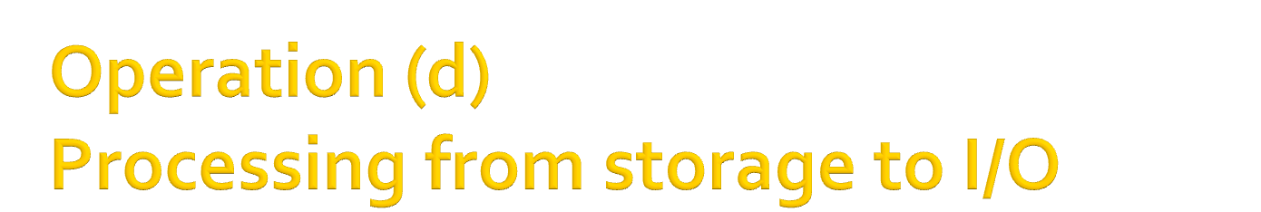

Slide 15
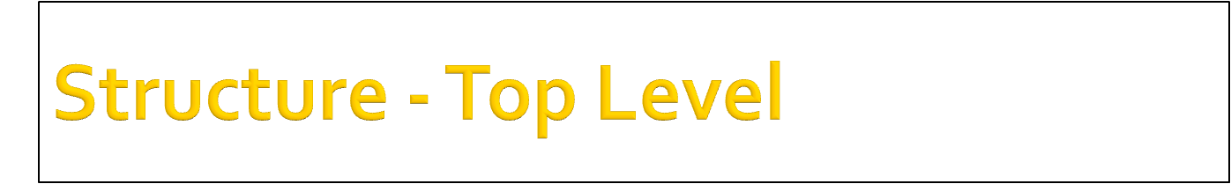
Peripherals
Computer
Central
Processing
Unit
Main
Memory
Computer
Systems
Interconnection
Input
Output
Communication
lines

Slide 16
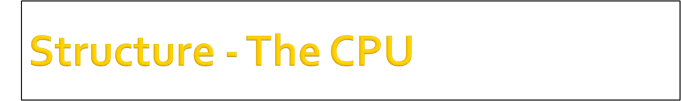
CPU
Computer
Arithmetic
and
Login Unit
I/O
Registers
System
Bus
CPU
Internal CPU
Interconnection
Memory
Control
Unit

Slide 17
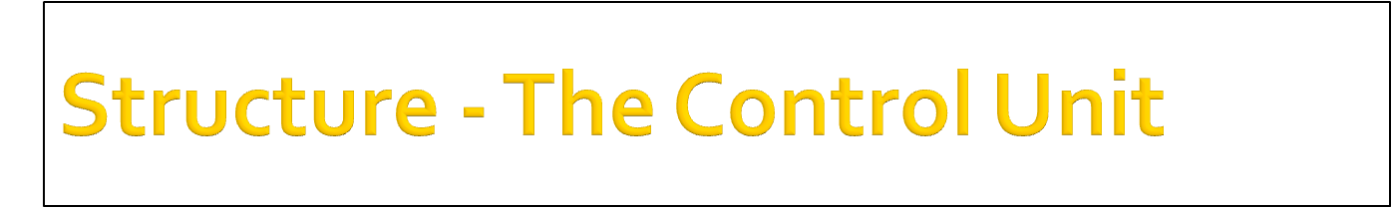
Control Unit
CPU
ALU
Sequencing
Login
Internal
Bus
Control
Unit
Control Unit
Registers and
Decoders
Registers
Control
Memory

